Slide 1
Video Coding
EE 446/646 Information and Coding Theory
Himali Singh 160003020
Khushboo Ahuja 160002024
Naman Singhal 160001038

Slide 2
What is a video?
Visual multimedia source that combines a sequence of images to form a moving picture.
The video transmits a signal to a screen and processes the order in which the screen captures should be shown.
Videos usually have audio components that correspond with the pictures being shown on the screen.
First developed for mechanical television systems, which were quickly replaced by cathode ray tube (CRT) systems which were later replaced by flat panel displays of several types.

Slide 3
Analog Video vs Digital Video
Represents moving visual images using analog signals
Originally, exclusively a live technology.
Video tape recorder was later invented for recording analog video.
In 1951, the first VTR captured live images from television cameras and saving the information onto magnetic video tape.
However, video recorders were very costly. Prices gradually dropped over the years.
Represents moving visual images using digital data
It could not initially compete with analog video, due to early digital uncompressed video requiring impractically high bitrates.
Practical digital video was made possible with video coding techniques.
Digital video was later capable of higher quality and, eventually, much lower cost than earlier analog technology.

Slide 4
Characteristics of a Video File

Slide 5
Display Resolution
Aspect Ratio
Number of distinct pixels in each dimension that can be displayed
It is usually quoted as width × height, with the units in pixels.
For eg., a popular resolution, 1080p or Full HD, has resolution 1920 x 1080 indicating the width of 1920 pixels and the height of 1080 pixels.
The ratio of the width of an image to its height
It is commonly expressed as two numbers separated by a colon, as in 16:9.
Widely used aspect ratios include 1.85:1 and 2.39:1 in film photography, 4:3 and 16:9 in television, and 3:2 in still camera photography.

Slide 6

Frame & Frame Rate
In filmmaking, video production, animation, and related fields, a frame is one of the many still images which compose the complete moving picture.
Frame rate is the frequency (rate) at which consecutive frames appear on a display.
Frame rate is expressed in frames per second or FPS.
The human visual system can process 10 to 12 images per second and perceive them individually, while higher rates are perceived as motion.
The industry standard of frame rate for films is 24 FPS
This animated cartoon is displayed at 12 drawings per second, and the fast motion is on the edge of being objectionably jerky.
GIF Source : Wikipedia

Slide 7
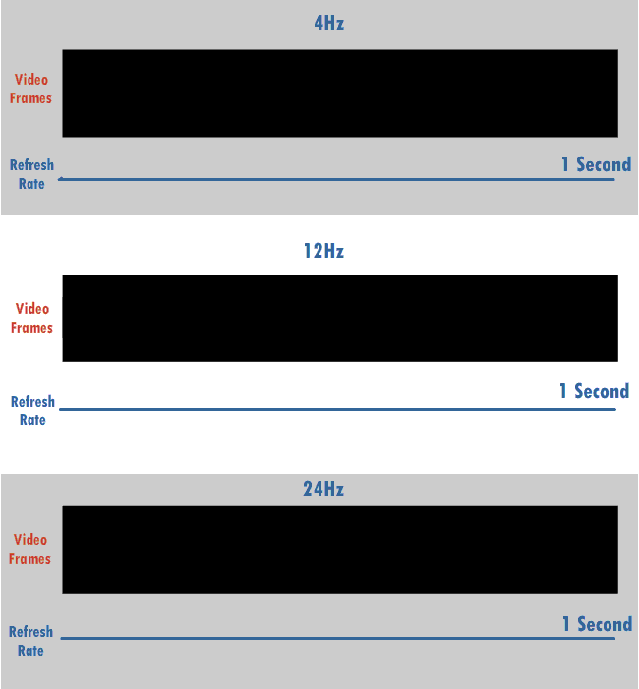
Refresh Rate
Number of times in a second that a display hardware updates its buffer.
The refresh rate includes the repeated drawing of identical frames, while frame rate measures how often a video source can feed an entire frame of new data to a display.
For eg., most movie projectors advance from one frame to the next one 24 times each second. But each frame is illuminated two or three times before the next frame is projected. As a result, the movie projector runs at 24 frames per second, but has a 48 or 72 Hz refresh rate.
Refresh Rate - 4Hz, 12Hz, 24Hz; Frame Rate - 24 FPS
GIF Source : Wikipedia

Slide 8
Color Model
Color Depth
A color model is an abstract mathematical model describing the way colors can be represented as tuples of numbers, typically as three or four values or color components.
For eg. YCbCr color model is used for digital video.
Other examples include RGB, YIQ, YUV color models.
The number of bits used to indicate the color of a single pixel, in a bitmapped image or video framebuffer, or the number of bits used for each color component of a single pixel.
When referring to a pixel, the concept is bits per pixel (bpp) defined as bits per pixel (bpp) and when referring to a color component, the concept is defined as bits per component (bpc).

Slide 9





24 bit, 16,777,216 colors, 98 KB
8 bit, 256 colors, 37 KB
4 bit, 16 colors, 13 KB
2 bit, 4 colors, 6 KB
1 bit, 2 colors, 4 KB
Same image on five different color depths (bits)
Image Source : Wikipedia

Slide 10
Bit Rate & Bits Per Pixel (BPP)
Bit rate is the number of bits that are conveyed or processed per unit of time, thus is a measure of the rate of information content of the digital video stream.
Bit rate corresponds directly to the quality of the video as bit rate is proportional to every property that affects the video quality.
The video size is proportional to the bit rate and the duration.
Video compression is used to greatly reduce the bit rate while having a lesser effect on quality.
Bits per pixel (BPP) is a measure of the efficiency of compression.
A true-color video with no compression at all may have a BPP of 24 bits/pixel. Applying jpeg compression on every frame can reduce the BPP to 8 or even 1 bits/pixel. Applying video compression algorithms like MPEG1, MPEG2 or MPEG4 allows for fractional BPP values.

Slide 11
Motivation - Why do we need Video Coding?
Uncompressed digital video delivers maximum quality, but with a very high data rate. Because of the large amount of storage and bandwidth needed to record and convey raw video, a method was needed to reduce the amount of data used to represent the raw video. Since then, engineers and mathematicians have worked on developing methods to compress the video for practical usage.
In 1974, discrete cosine transform (DCT) compression was introduced by Nasir Ahmed, T. Natarajan and K. R. Rao. During the late 1980s, a number of companies began experimenting with DCT lossy compression for video coding, leading to the development of the H.261 standard. H.261 was the first practical video coding standard, and was developed by a number of companies, including Hitachi, PictureTel, NTT, BT, and Toshiba, among others. Since H.261, DCT compression has been adopted by all the major video coding standards that followed.

Slide 12
Major Video coding initiatives and standards
Video coding for video teleconferencing, which has led to the ITU standards – H.261 for ISDN video conferencing, H.263 for very low bitrate and Plain Old Telephone Systems (POTS) video conferencing and the latest H.264 for video telephony and video streaming in wireless applications.
Video coding for storing movies on CD-ROM, with a bit-rate up to 1.5 M bits/sec, of which 1.2 Mbits/sec is allocated to video and 256 Kbits/sec is allocated to the audio. This is addressed by ISO MPEG-1.
Video coding for broadcast and storing video on digital video disks (DVD) with an order of 2-15 Mbits/sec allocated to audio and video coding, which led to the ISO-MPEG-2 standard. This, standard also addressed High Definition Television (HDTV) applications.
Coding of separate audio-visual objects, both natural and synthetic, which led to the ISO-MPEG-4 standard.
Coding of multimedia metadata, i.e., the data describing the features of multimedia data, which is being addressed in the upcoming MPEG-7 standard

Slide 13
Introduction to Video Coding
A wide range of emerging applications, such as conversational video like video telephone , video conferencing through wired and wireless medium; streaming video, such as video on demand; digital TV/HDTV broadcasting , image / video database services, CD/DVD storage etc, demand significant amount of data compression.
Video Coding is the process through which this compression can be achieved. In the subsequent presentation, we aim to introduce the process of video coding and decoding along with a working example using python code and the various standards of video coding.

Slide 14
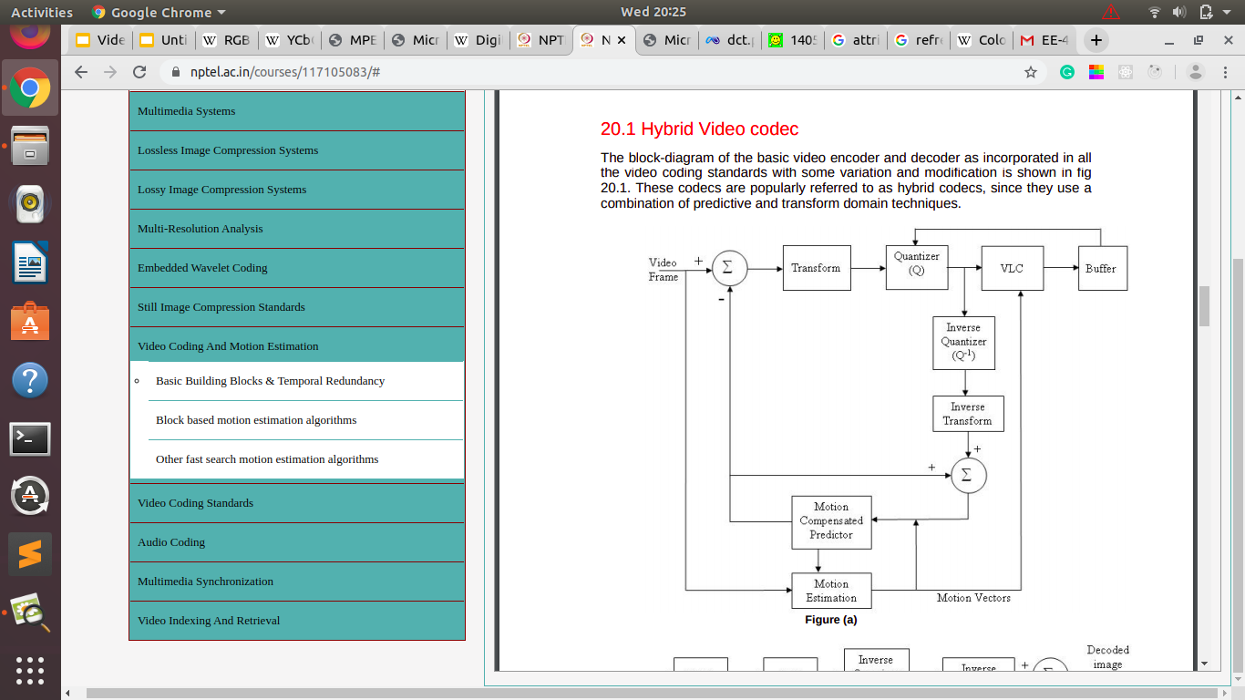
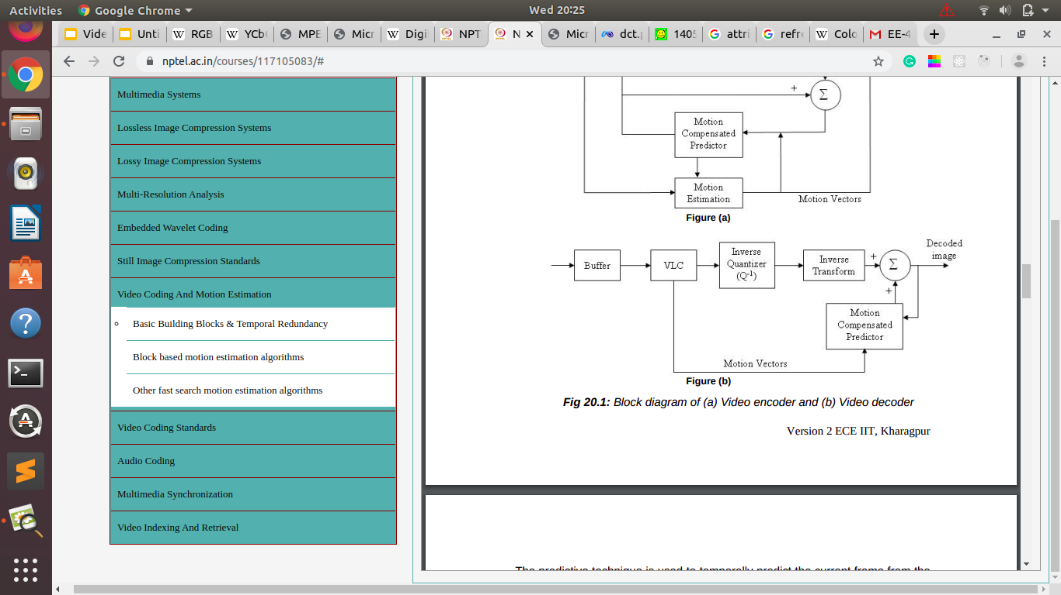
Hybrid Video Codec
Video Decoder
Video Encoder
Image Source : NPTEL

Slide 15
Hybrid Video Codec
The predictive technique is used to temporally predict the current frame from the previous one(s) that must be stored.
The temporal prediction is based on the assumption that the consecutive frames in a video sequences exhibit very close similarity.
The predicted frame generated by the exploitation of temporal redundancy is subtracted from the incoming video frame, pixel by pixel and the difference is the error image.
The error image goes through transforms as in still image codecs to exploit spatial redundancy.
The transformed coefficients are quantized and entropy coded before adding to the bit stream.

Slide 16
Hybrid Video Codec
The encoder has a built in decoder too so as to reconstruct the error frame, which will not be exact, because of the quantizer.
The error frame is added to the predicted frame to generate the buffer.
The motion estimation block determines the displacement between the current frame and the stored frame.
The displacements so computed are applied on the stored frame in the motion compensation unit to generate the predicted frame.

Slide 17
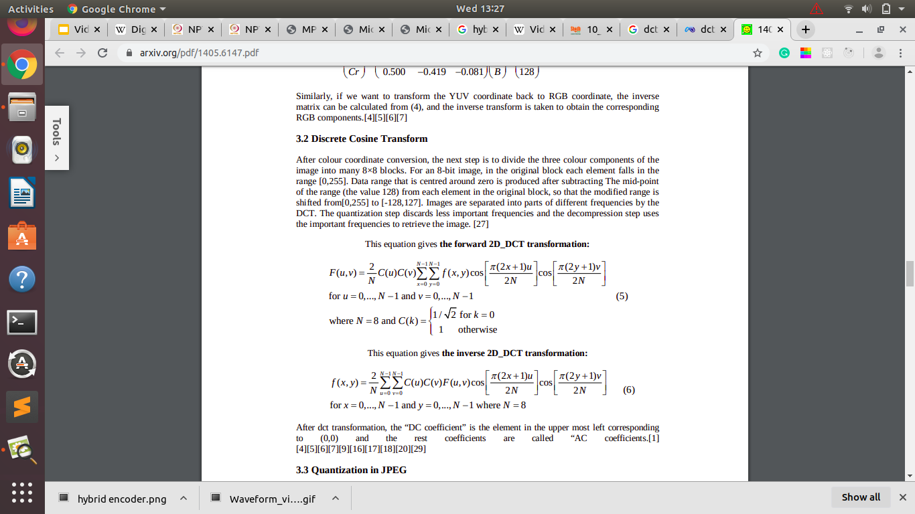
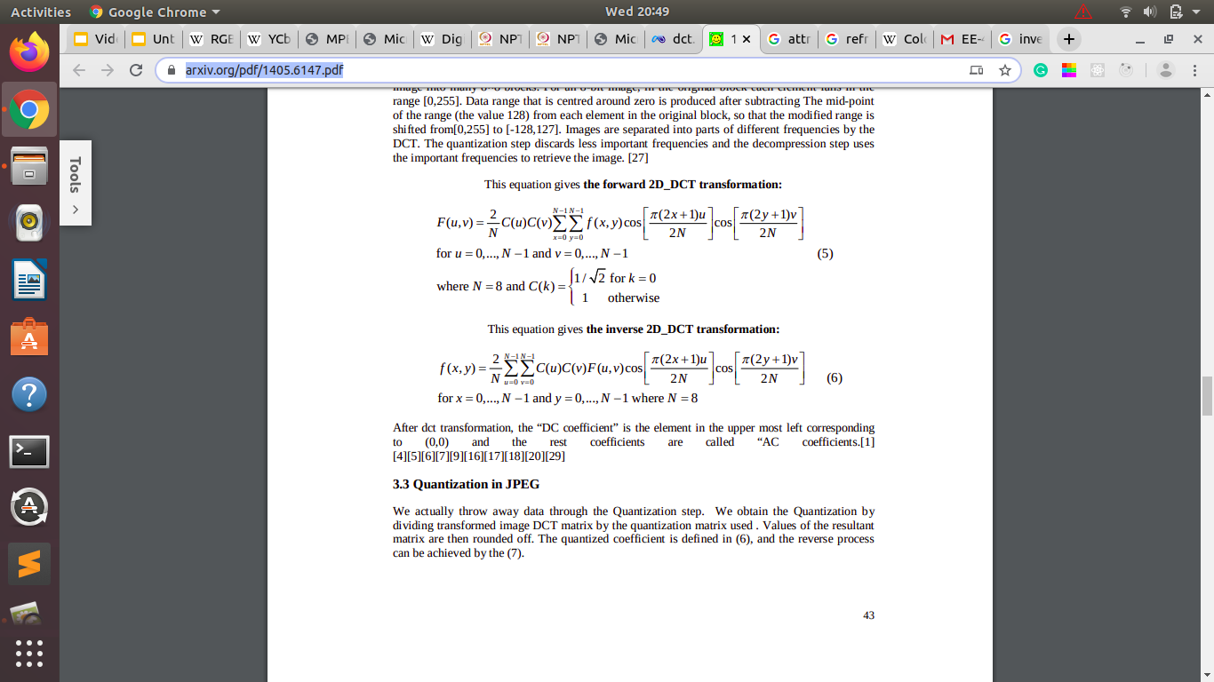
Discrete Cosine Transform (DCT)
￼
Most popular transform for image compression due to its high energy compaction
Used to map an image space into frequency domain
Generally, N = 8 is used for image compression applications where image blocks of size 8 x 8 are converted into the frequency domain.
Inverse Discrete Cosine Transform (IDCT) is used for inverse transform
The equation for 2D NxN DCT and IDCT is given by-
DCT
IDCT

Slide 18
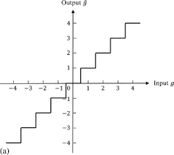
Quantization
Used to reduce a range of numbers to a single small value, so that we can use less bits to represent a large number.
A quantizer step size (Q) and a round function is defined
x_{q}=round (x/Q)
Larger Q leads to more compression but at the cost of larger distortion.
e.g. for x in [0,255], we need 8 bits and have 256 color values – with Q=64 we only have 4 levels and only need 2 bits
Inverse Quantization (dequantize) is used to reconstruct original value. But as we use Round() function to get a nearest integer value, so reconstructed value will not the same with original value.
In general if we carefully design Q[i,j], visual quality will not be affected.
An example of uniform quantizer function
Image Source : Science Direct

Slide 19
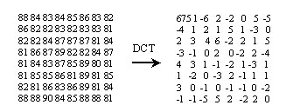
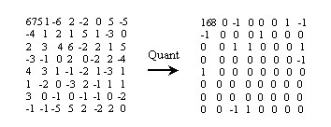
Example of application of 8 x 8 DCT and Quantization with quantizer factor 4 to an 8 x 8 block of an image.
Image Source : www.cmlab.csie.ntu.edu.tw

Slide 20
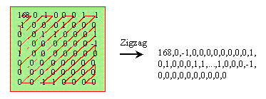
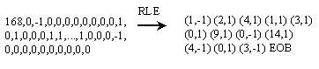
Zig Zag Scan and Run Length Encoding (RLE)
Zig zag scan and RLE are often applied after the quantization step.
After DCT and quantization most AC values will be zero. By using zig-zag scan we can gather even more consecutive zeros, then we use RLE to gain compression ratio.
After zig-zag scan, many zeros are together now, so we encode the bitstream as (skip,value) pairs, where skip is the number of zeros and value is the next non-zero component.
Zig-zag scan and RLE are only used in AC coefficient. DPCM is used for DC coefficient.
Image Source : www.cmlab.csie.ntu.edu.tw

Slide 21
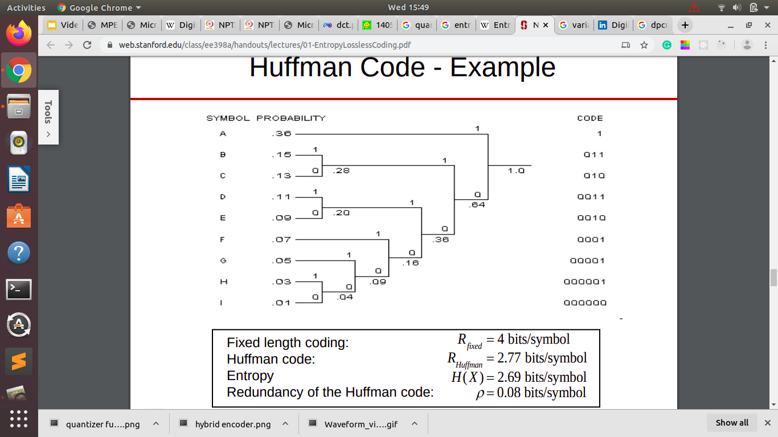
Entropy Encoding
It is a lossless data compression scheme
Entropy encoding can be categorized into fixed length coding (FLC) and variable length coding (VLC)
VLC has added advantages over FLC as it uses shorter codes for more likely outcomes leading to more compression.
In VLC, optimal code length for a symbol is −log_{b}P, b=number of symbols, P=probability of the input symbol.
Two of the most common entropy encoding techniques are Huffman coding and arithmetic coding.
Huffman Coding Example
Image Source : www.web.stanford.edu

Slide 22
Motion Estimation and Motion Compensation
The motion estimation block computes the displacement between the current frame and a stored past frame that is used as a reference. Usually the immediate past frame is considered to be the reference.
Considering a pixel from the current frame with its neighbourhood as the candidates, the best matching position in the reference frame is determined.
The difference in position between the candidates and its match is defined as the displacement or motion vector. The motion vector has both horizontal and vertical components of displacement.
The motion compensation block predicts the current frame by applying the displacements corresponding to the motion vectors on the reference frame.
Here, it is assumed that the displacement is purely translational. Any scaling, rotation or 3-D deformation is neglected. The assumptions are reasonable for movement of objects over one frame in block based motion estimation.

Slide 23
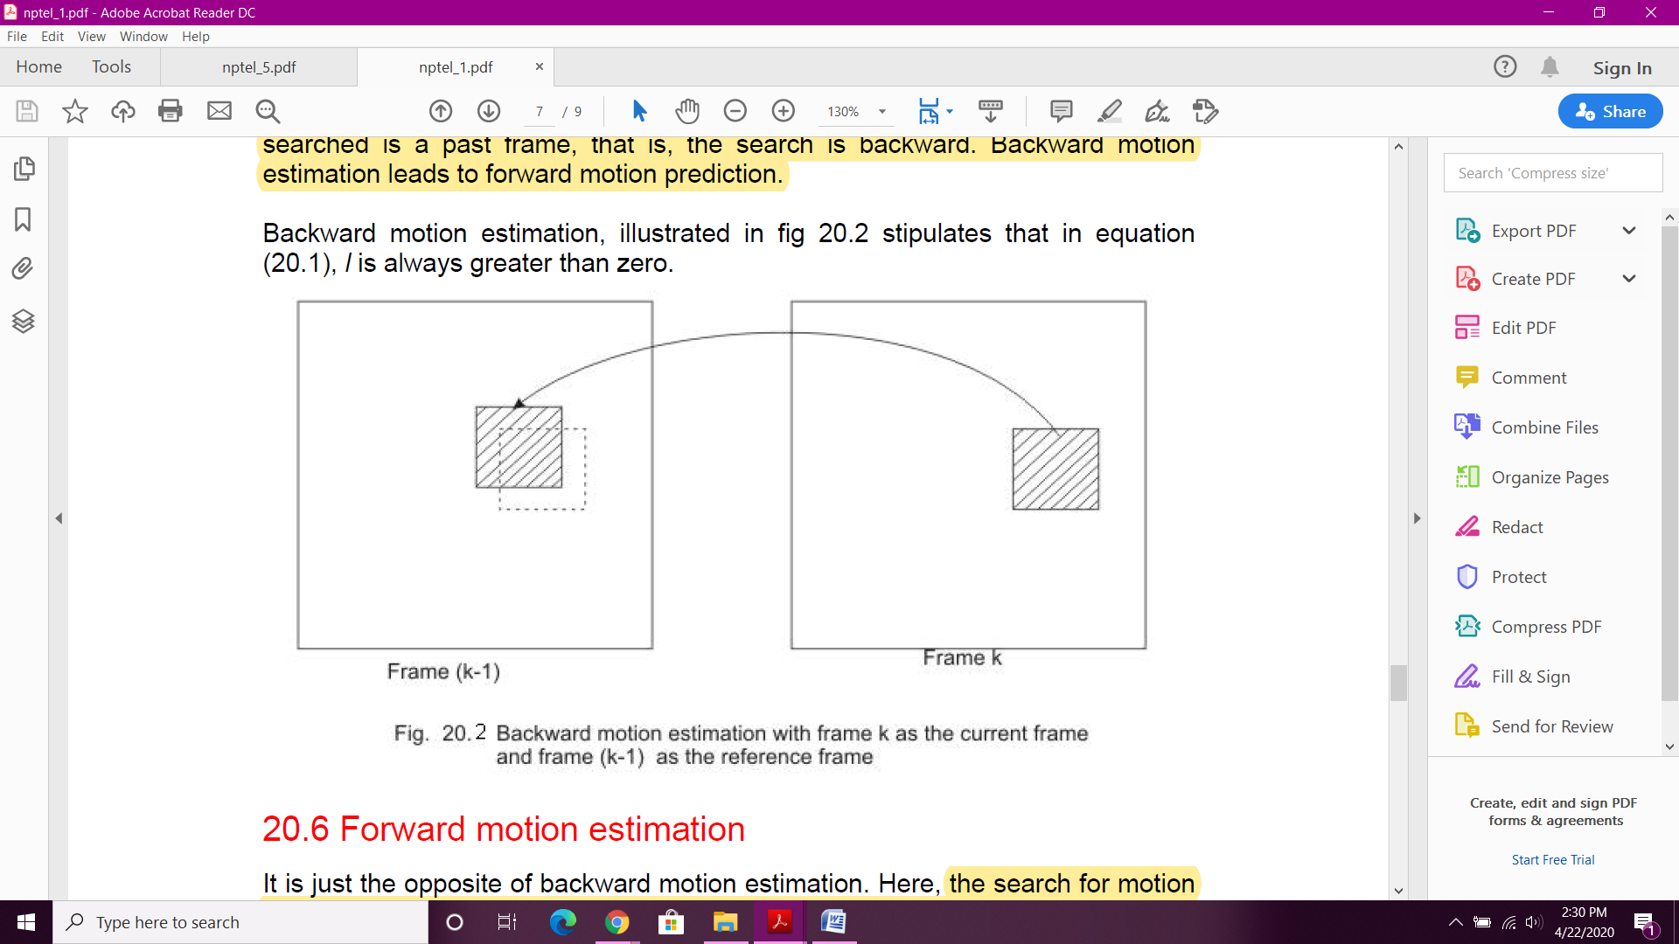
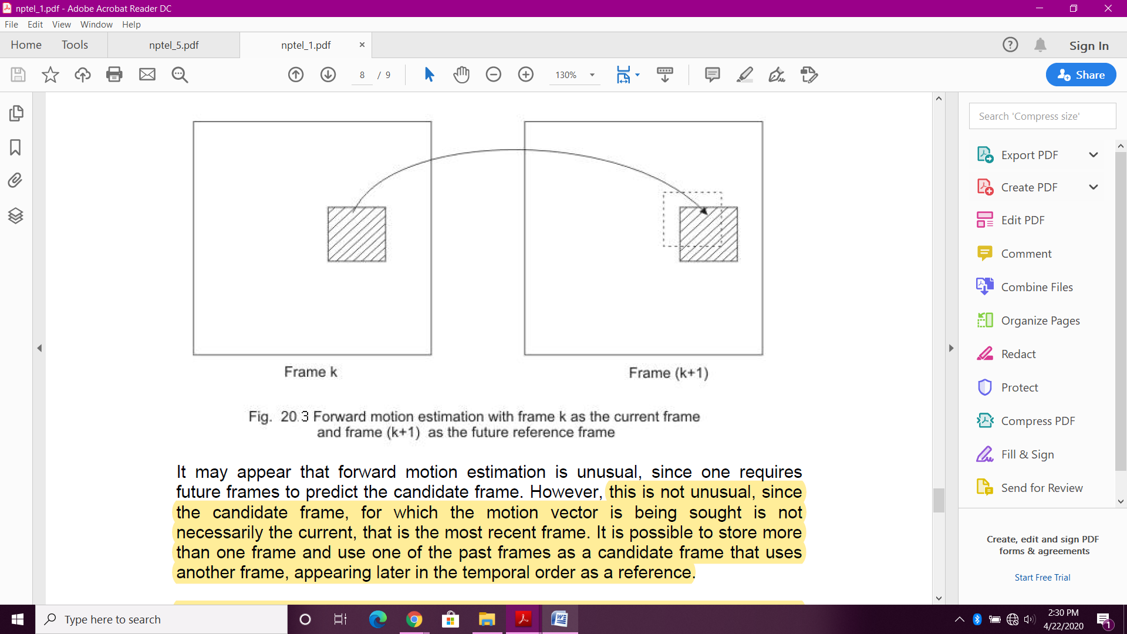
Backward and Forward motion estimation
In backward motion estimation, the current frame (Frame k) is considered as the candidate frame and a past frame (Frame (k-1) )is considered as the reference frame. The search for motion vectors is backward which leads to forward motion prediction.
In forward motion estimation, the reference frame (Frame (k+1)) chosen is a frame that appears later than the candidate frame in temporal ordering. Here, the candidate frame is one of the past stored frames. The search for motion vectors is forward which leads to backward motion prediction.
Forward motion estimation
Backward motion estimation
Image Source : NPTEL

Slide 24
Motion estimation approaches
Pixel based and block based are the two approaches used for motion estimation. In pixel based approach, the motion vectors are determined for every pixel in the image assuming brightness constancy. Due to various constraints, this approach requires large computation time.
In block based approach, the candidate frame is divided into non-overlapping blocks, say of size 16x16 pixels, and a single motion vector is determined for the entire block.
Block based motion estimation approach is easy to implement in hardware and real time motion estimation and prediction is possible. Hence, it is accepted in all video coding standards proposed till date.
Different motion estimation algorithms have been proposed for block based approach. Full search block motion (FSBM) is the simplest but computational complex algorithm. Hence, several quick and efficient methods like 2-D logarithmic search, cross search algorithm (CSA), diamond search (DS) etc. have been proposed.

Slide 25
Simple Video Compression
Our own Video Compression Algorithmic Implementation using Python and OpenCV

Slide 26
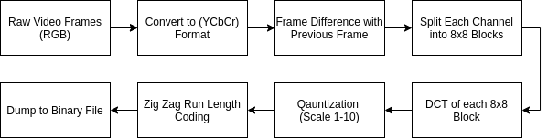
Video Compression Flow

Slide 27
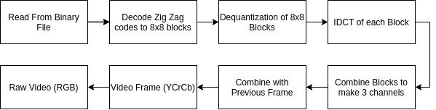
Video Decompression Flow

Slide 28
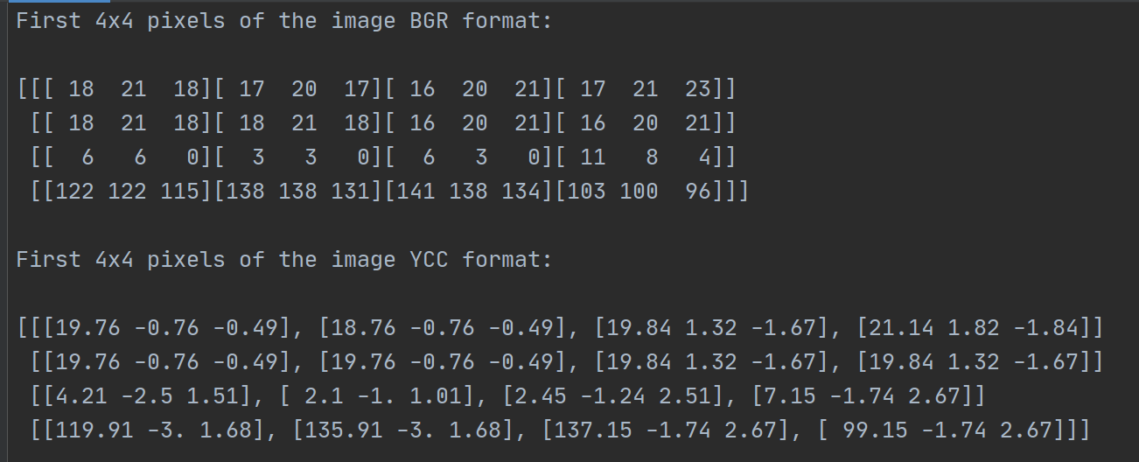
Let’s do a Walkthrough

Slide 29
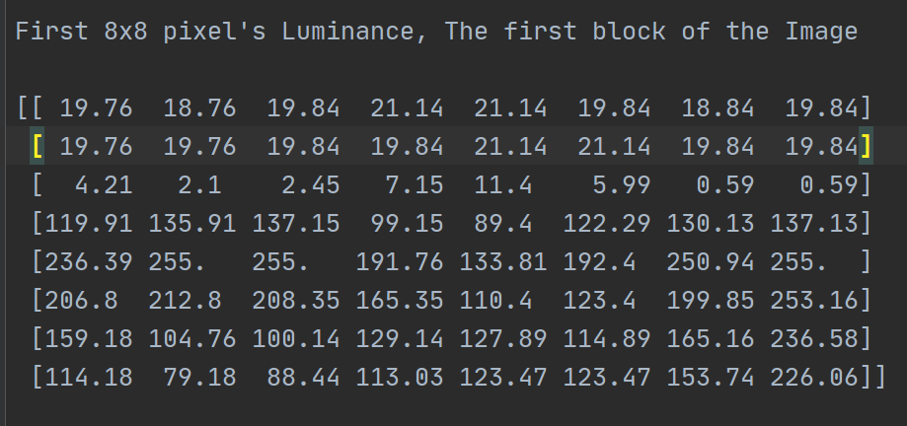
Let’s do a Walkthrough

Slide 30
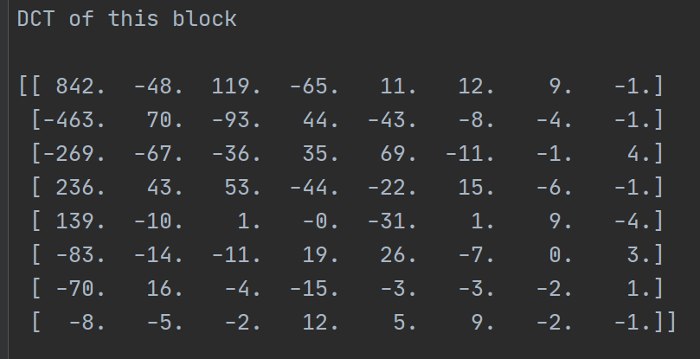
Let’s do a Walkthrough

Slide 31
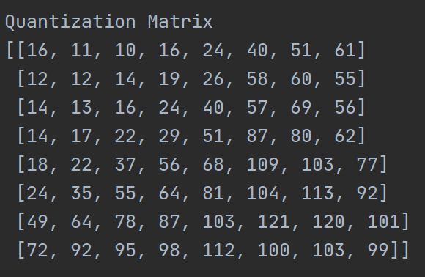
Let’s do a Walkthrough

Slide 32
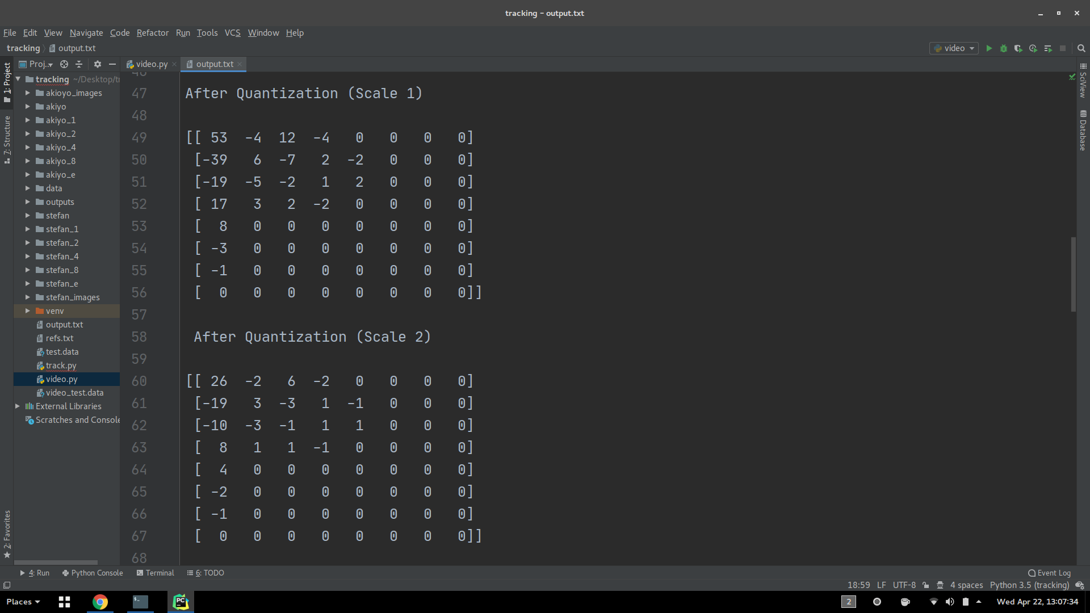
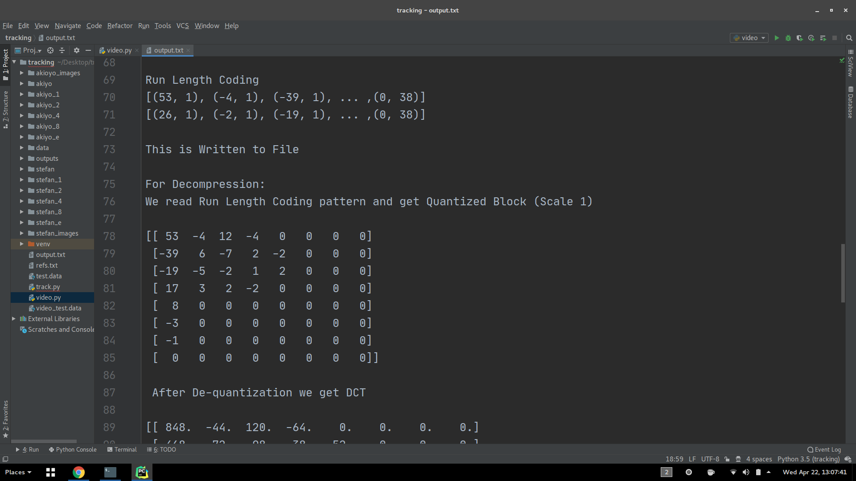

Slide 33
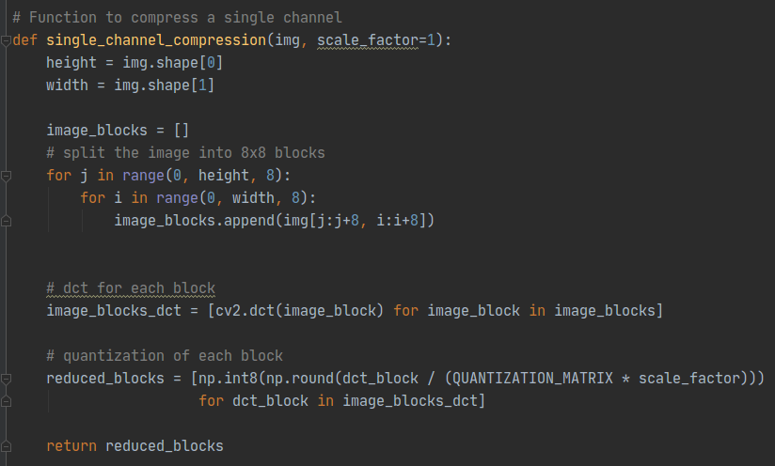

Slide 34
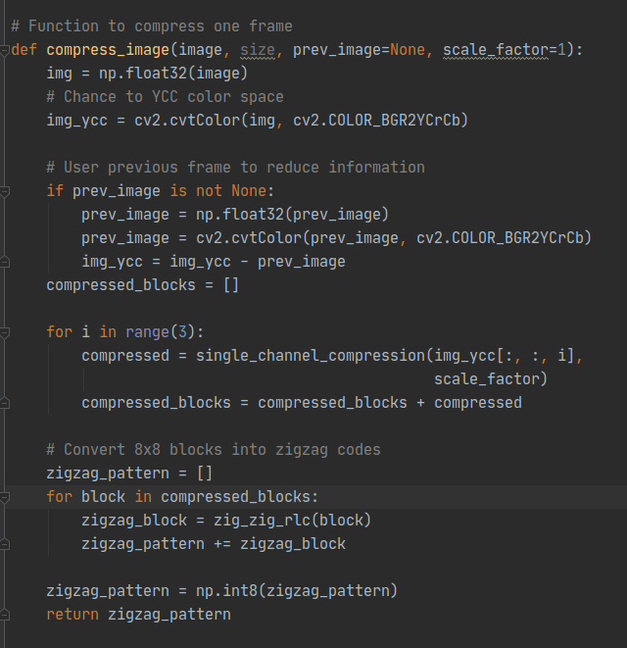

Slide 35
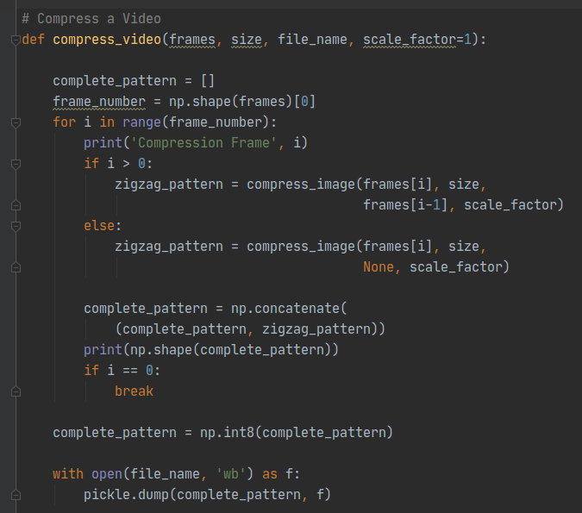

Slide 36

Comparison (4 x 4)
Uncompressed
Compressed

Slide 37

Comparison (8 x 8)
Uncompressed
Compressed

Slide 38

Comparison (16 x 16)
Uncompressed
Compressed

Slide 39

Comparison (32 x 32)
Uncompressed
Compressed

Slide 40

Comparison (64x64)
Uncompressed
Compressed

Slide 41
Results
Compression | Akiyo 352x288 300-Frames | Stefan 352x288 90-Frames
Raw Video | 45.6 MB | 13.7 MB
Simple Compression Scale 1 | 13.2 MB | 8.1 MB
Simple Compression Scale 2 | 9.7 MB | 6.0 MB
Simple Compression Scale 4 | 7.4 MB | 4.3 MB
Simple Compression Scale 8 | 6.0 MB | 3.0 MB
Simple Compression with Frame Difference | 3.8 MB | 7.4 MB
MPEG-4 | 651.6 KB | 1.6 MB

Slide 42
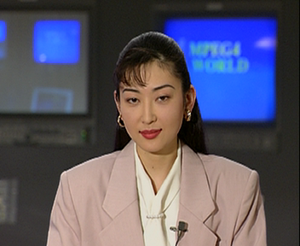

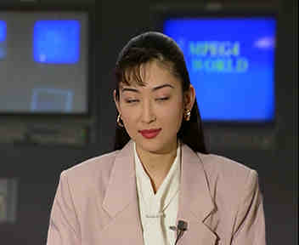
Results (akioyo)
Raw
Scale 1
Scale 2

Slide 43
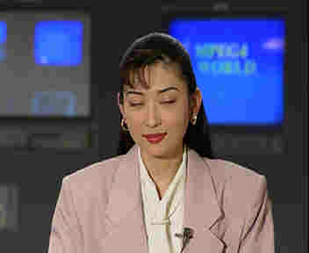


Results (akioyo)
Scale 4
Scale 8
Frame Difference

Slide 44
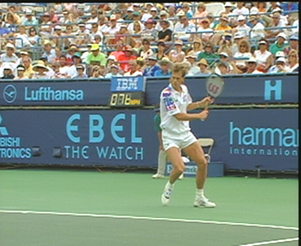

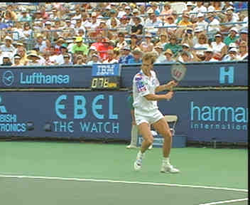
Results (stefan)
Raw
Scale 1
Scale 2

Slide 45
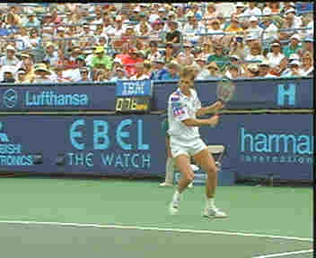
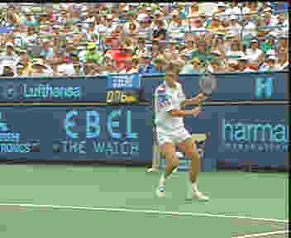
Results (stefan)
Scale 4
Scale 8
Frame Difference

Slide 46
MPEG-1 standard and its features
MPEG-1 standard was primarily targeted for multimedia CD-ROM applications at a bit rate of 1.5 Mbits/sec. It specifies a syntax for representation of the encoded bitstream and the method of decoding with substantial flexibility in a number of parameters that can be specified in the bitstream itself including picture sizes and frame rates.
The main features supported by MPEG-1 are:
Frame-based random access of videos
Fast-forward and fast reverse (FF/FR) searches
Reverse playback of video
Edit ability of compressed bit stream
MPEG-1 works with (Y,Cb,Cr) colour space where Y is the luminance component and Cb & Cr are the two chrominance components.

Slide 47
Picture types in MPEG-1
Intraframe coded pictures (I-pictures)
coded without reference to other pictures just like still images
The first frame of every video sequence is an I-picture
With no temporal prediction, they achieve very poor compression performance but allow random access and FF/FR functionalities in the bitstream.
Interframe predicted pictures (P-pictures)
coded with reference to the nearest coded I-picture or P-picture using motion compensation
achieve better compression as compared to I-pictures but do not allow random access and FF/FR functionalities
Temporal prediction does not work where there are scene changes.
Bi-directionally predicted pictures (B-pictures)
Use bi-directional motion estimation with reference to the nearest coded I-picture and/ or P-picture on either side in temporal order
Having best compression performance, almost two thirds of frames are B-pictures.
also provides better SNR as compared to P-picture

Slide 48
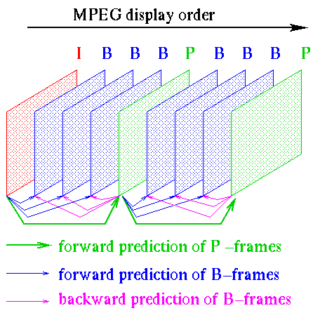
Image Source : www.researchgate.net

Slide 49
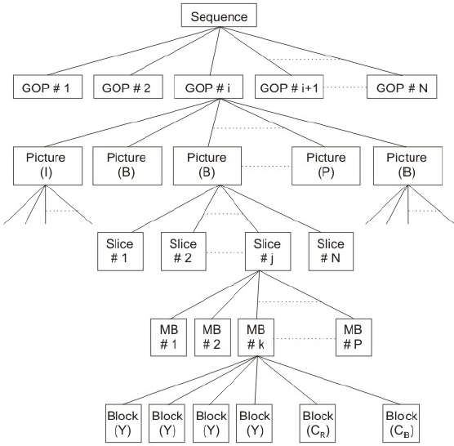
Hierarchical data structure in MPEG-1
MPEG-1 datastream follows a 6 layer hierarchical structure.
The video sequence is divided in several group of pictures (GOPs).
Each of the six layers have headers to uniquely specify the data that follows.
Image Source : NPTEL

Slide 50
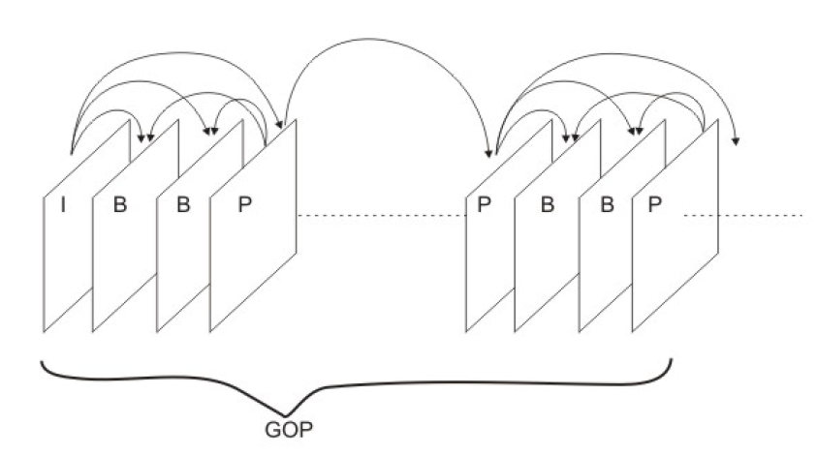
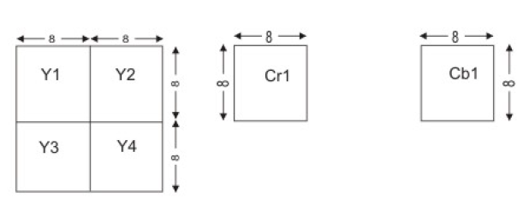
Hierarchical data structure in MPEG-1
Each GOP begins with an I - picture.
P-pictures are encoded at regular intervals (3 or 4 frames) and the frames between the I-picture and P-pictures are encoded as B-pictures.
The pictures are composed of slices which are sequence of macroblocks (MBs).
Each macroblock is composed of 16X16 pixels of Y channel (subdivided into four blocks of 8X8 pixels) and one block of 8X8 pixels from each Cr and Cb channels. Hence, each macroblock consists of six 8X8 blocks.
Composition of Macroblock
Image Source : NPTEL

Slide 51
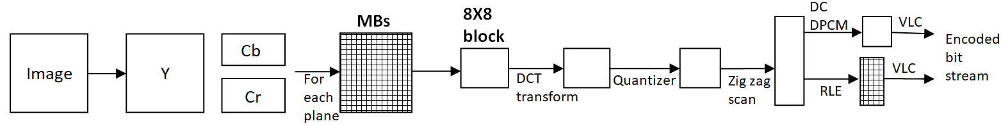
Intra frame encoding for I-pictures
Image Source : www.cmlab.csie.ntu.edu.tw
A total of six 8X8 blocks are encoded for each macroblock.
DPCM: Difference pulse coded modulation (predictive coding) used to encode the DC coefficient only.
RLE: Run length encoding used to encode the AC coefficients
VLC: Variable length coding used to encode the DPCM and RLE encoded coefficients

Slide 52
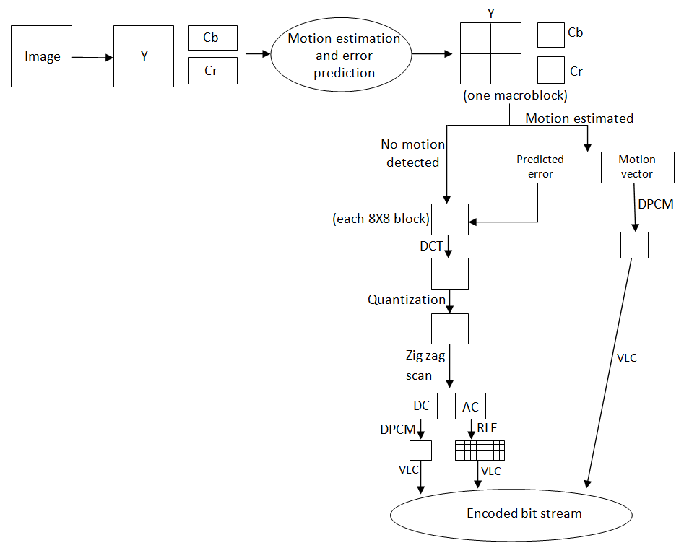
Interframe encoding for P-pictures and B-pictures
In case of P-picture & B-pictures, motion estimation is done using a reference frame from the frame buffer. The difference in current frame and motion compensated frame is predicted (error).
If, there is no error, the frame is encoded just like an I-picture. If a motion error is present, the error is encoded using DCT transform and the motion vector is encoded using DPCM and added to the bitstream.
The frame is reconstructed from the DC and AC coefficients after quantization and stored in the frame buffer if required.
Image Source : www.cmlab.csie.ntu.edu.tw

Slide 53
MPEG-2 standard
MPEG-2 was developed as a standard for high quality multi-channel, multimedia signals for terrestrial broadcast, digital and cable TV distribution etc. It was also adopted in DVDs.
It was designed for coding interlaced images with bit rate around 4 Mbps. In interlaced scanning, the frame is partitioned into odd field (set of odd-numbered scan lines) and even field (set of even-numbered scan lines). Each field is coded separately which gives better results in presence of significant motion. Such pictures are known as field pictures.
Various profiles and levels are defined to suit wide range of applications. Each profile adds a new set of algorithms and a level specifies the range of parameters like image size, frame rates etc.
It supports scalability to provide interoperability between different services and to support receivers with different display capabilities. The bit stream is organized into two or three layers. The bottom layer is the base layer which every receiver must make use of above which are the enhancement layers for high end applications. This finds use in SDTV and HDTV applications.
Every MPEG-2 compatible decoder can decode a valid MPEG-1 bit stream i.e. backward compatibility with MPEG-1.

Slide 54
MPEG-4 standard
Unlike MPEG-1 & MPEG-2, MPEG-4 was not confined to rectangular sized pictures. It adopted an object based coding concept to individually encode and transmit arbitrarily shaped and dynamically changing individual audio-visual objects in a video sequence.
It addressed very low bit rate coding (5 - 64 Kbits/sec) to 2 Mbits/sec for TV/film applications.
It has a wide range of applications including internet streaming, wireless video, digital video cameras, mobile phones etc.
It has an ability to encode multiple views, for example stereoscopic video.
An important feature of MPEG-4 is sprite coding. Sprite assumes a flat and static background. Using video segmentation algorithms to extract the foreground and background, the background is encoded separately and only transmitted once before the foreground.

Slide 55
H.264 standard
The main features of H.264 standard are as follows:
Improved motion estimation upto quarter- pixel accuracy
Use of 4X4 integer transforms in place of 8X8 DCT
Advanced prediction modes for intracoded and inter-coded frames
Improved context based arithmetic entropy encoding
Enhanced compression performance in conversational (like video telephony and video conferencing) and non conversational (like storage, broadcast and streaming) applications
A wavelet based filter to reduce the artefacts caused because of separate compression of individual macroblocks

Slide 56
Comparison and Performance Metrics???
Video Codecs cannot be compared based on just the “Compression Ratio” or “Encoding/Decoding Time”
Resultant Video Quality and Compression Artifacts are major factor which cannot be easily quantified
Industries use various codecs depending on their use cases

Slide 57
Future of Video Compression?
The most popular video coding standards used for codecs have been the MPEG standards.
The most widely used video coding format, as of 2016, is H.264/MPEG-4 AVC (2003).
H.264 is the used in Blu-ray Discs, YouTube, Netflix, Vimeo, iTunes Store, Adobe Flash Player and HDTV television broadcasts.
AVC has been succeeded by HEVC/H.265 (2013), it is currently heavily patented.
MPEG also working on many future standards like VVC/H.266, MPEG-5 Part 1/EVC and MPEG-5 Part 2/LCEVC, all of which are expected to release in 2020/2021
Notes:
Versatile Video Coding (VVC)
EVC (Essential Video Coding)
Low Complexity Enhancement Video Coding (LCEVC)

Slide 58
Ever Changing Applications
Applications and Requirements of Video Codecs are ever changing with new uses and each needed their special codecs
Video Calling
Live Streaming (Sports and TV)
Sensor data
Game Streaming
180° and 360° Video
Virtual Reality Content

Slide 59
Thank You !!!!
All Question and Queries to:
Himali Singh (160003020)
Khushboo Ahuja(160002024)
Naman Singhal(160001038)

Slide 60
References
Raid, A.M., Khedr, W.M., El-Dosuky, M.A. and Ahmed, W., 2014. Jpeg image compression using discrete cosine transform-A survey. arXiv preprint arXiv:1405.6147.
CMLAB - Communications and Multimedia Laboratory (cmlab.csie.ntu.edu.tw/cml/dsp/training/coding/mpeg1/index.html)
NPTEL - National Programme on Technology Enhanced Learning (nptel.ac.in/courses/117105083/)
https://web.stanford.edu/class/ee398a/handouts/lectures/01-EntropyLosslessCoding.pdf
Raw Video Data - http://trace.eas.asu.edu/yuv/
Wikipedia.org
ScienceDirect (https://www.sciencedirect.com/topics/engineering/uniform-quantization)

